Slide 1

Using Animal Control Incident Data to Improve Animal Welfare by Community
Rebecca Lewis Bellevue University DSC 680 – Project 1 April 11, 2021
https://github.com/RebeccaLewis-DS/dsc680-project1
Notes:
Using Animal Control Incident Data to Improve Animal Welfare by Community
By Rebecca Lewis for Bellevue University’s Data Science 680 course
Presented on April 11, 2021
Accompanying paper, data, and code can be found in my github account at github.com/RebeccaLewis hyphen DS slash dsc680 hyphen project1

Slide 2

Introduction
Why do we care about animal welfare?
Who is an Animal Control Officer?
What problems need to be solved?
How can we solve them?
How can predictive analytics help?
Notes:
In this presentation, you will learn about the humane law enforcement part of animal welfare, more commonly known as animal control. Animal control officers often have a negative connotation and are sometimes seen as just dog catchers. However, they play an important role in improving the lives of animals and people in the community. Before we look at how we can use incident data to improve animal welfare problems, we need to understand why we should care about animal welfare, the services animal control officers provide for the community, the problems they can address each day, and the ways data can be used to solve them.

Slide 3
Why do we care about animal welfare?
Over 6.5 million animals enter shelters each year.⁴
Approximately 1.5 million animals are euthanized.⁴
Notes:
So why should we care about animal welfare, According to the ASPCA, over 6.5 million animals enter shelters each year and of those animals 1.5 million are euthanized. Animals of all species and breeds enter shelters in multiple ways. They can be surrendered by their former owners, rescued by individuals or authorities as strays, or confiscated from a cruelty case.

Slide 4
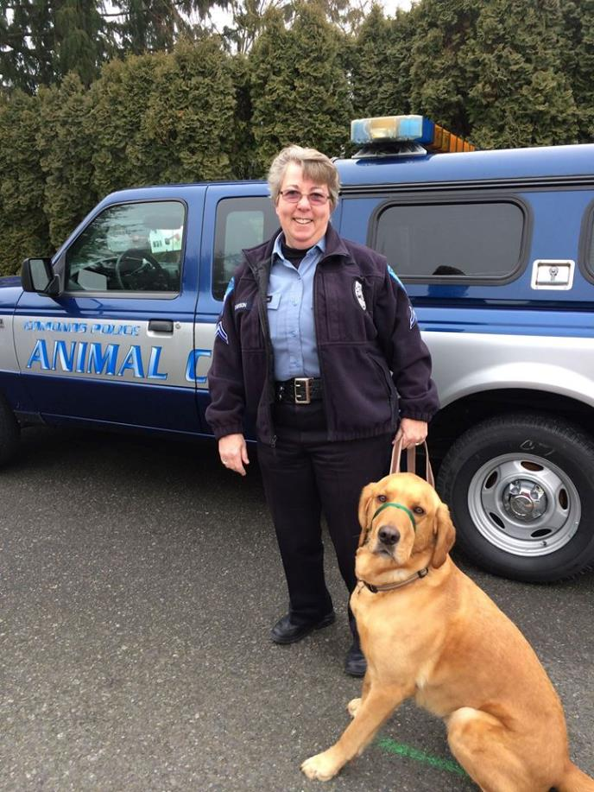
Who is an Animal Control Officer?
Animal control officers play an important role in improving the welfare of animals in the community.
The mission of the Baton Rouge Animal Control and Rescue Center is “protecting animals from people and people from animals.”²
They are responsible for investigating animal related complaints, resolving animal related issues, and enforcing the local laws surrounding animals.²
This Photo by Unknown Author is licensed under CC BY
Notes:
Most municipalities have an animal control or humane law entity that is responsible for responding to animal complaints and emergencies. Sometimes these agencies are publicly funded, and sometimes they are part of a private nonprofit animal welfare organization. Animal control officers sometimes have a bad reputation, but often their desire is to maintain the best quality of life for animals in the community. The data used in this project comes from the Baton Rouge Animal Control and Rescue Center, which is responsible for investigating animal related complaints, resolving animal related issues, and enforcing the local laws surrounding animals in East Baton Rouge Parish. Their mission is to ““protecting animals from people and people from animals.” And for those not from Louisiana, we have parishes, instead of counties.

Slide 5
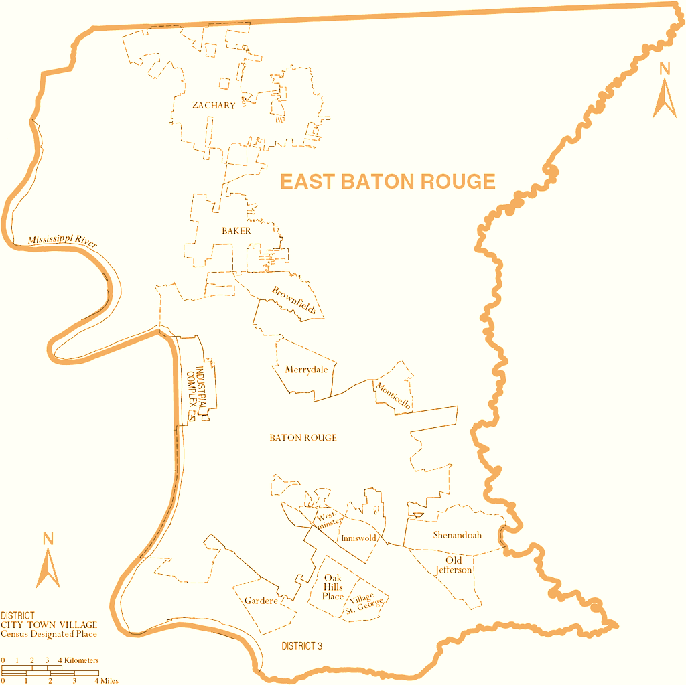
East Baton Rouge Parish⁵
Notes:
Here we can see a map of East Baton Rouge Parish, where the city of Baton Rouge is located. Other locations noted in the incident call log are Zachary and Baker which are just north of Baton Rouge. Incidents were also noted in a city called Central which is located just to the east of Baton Rouge. The parish is made up of municipalities as well as rural errors. The city of Baton Rouge takes up most of the area in the parish.

Slide 6
What problems need to be solved?
Pet Overpopulation
Dog Fighting
Feral Cats
Notes:
Animal control entities and nonprofit animal rescues often work together to improve the lives of animals in their local communities. Common problems that face the animal community can benefit from a closer look at animal control statistics. A few of these problems addressed in this project are pet overpopulation, dog fighting, and feral cat community control.
Pet overpopulation is caused by factors like allowing animals to breed without the likelihood of finding homes for the offspring.
Dog fighting is a brutal underground criminal activity that has led to a bad reputation for pit bull type dogs. Feral cats are free roaming cats that are considered wild and cannot easily be domesticated. They can offer benefits to their respective communities but are often picked up by animal control because they are considered a nuisance by neighbors.

Slide 7
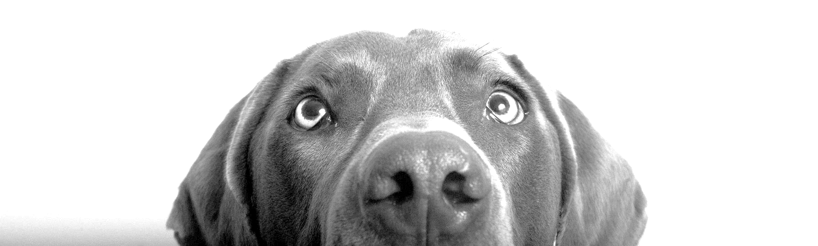
How can we solve them?
The objective of this project is to analyze incident data collected by an animal control agency and use it to provide vital information to address animal welfare problems by community.
Notes:
The objective of this project is to analyze incident data collected by an animal control agency and use it to provide vital information to address animal welfare problems by community, allowing organizations to efficiently direct resources to where they are needed most.

Slide 8


How can Predictive Analytics Help?
Condition
Temperament
Emaciated
Poor
Fair
Good
Excellent
Unknown
Friendly
Normal
Nervous
Scared
Dangerous
Unknown
Notes:
Another objective was to see if any details about an incident can be predicted prior to the officers’ arrival on the scene so they could be adequately prepared with staff and resources. Predictive analytics is a data science practices that uses historical data to make predictions about future events. The two target variables for prediction were condition and temperament. Condition describes the animal’s general health and temperament describes their demeaner.
Condition can be Emaciated, poor, fair, good, excellent or unknown. The temperament can be friendly, normal, nervous, scared, dangerous, or unknown.
It would be useful to predict this information based on the information available to the dispatcher at the time of the call so that officers can be prepared for an emergency or dangerous situation:
A poor condition may warrant medical assistance on the scene or a 24 hour clinic.
A dangerous temperament may require additional officers to respond.
Similarly, animals in excellent condition and a friendly temperament can be delegated to newer officers.

Slide 9
Analysis
Data Retrieval and Description
Data Preparation
Data Analysis
Making Predictions
What does it all mean?
Notes:
We will look at the discoveries in the data in just a few minutes, but first, I’d like to give you an idea of what information was in the incident logs. We will review how the data was retrieved and prepared before looking at the answers it provided with some visuals. We will then review if condition and temperament can be predicted before the officer arrives on the scene. We will then tie it all together and answer the question if whether animal control incident data can be used to improve animal welfare by community.

Slide 10
Data
Sources
Description
Baton Rouge’s Open Data website³
Kaggle¹
Dates and times for the call, dispatch, arrival, and completion of the incident
Animal attributes such as condition, temperament, sex, breed, species.
Latitude and Longitude where the incident occurred.
Notes:
A dataset of animal control incidents from 2012-2020 for East Baton Rouge Parish was downloaded from Baton Rouge’s Open Data Initiative website.
Another dataset containing the same data was downloaded from Kaggle contained geocoding for incidents from 2012-2019.
The most relevant information included:
Dates and times for the call, dispatch, arrival, and completion of the incident
Animal attributes such as condition, temperament, sex, breed, species.
Latitude and Longitude where the incident occurred.
A full data dictionary can be viewed on the Open Data Baton Rouge website.

Slide 11
Data Preparation
Filtered to incidents with geocoded locations.
Removed irrelevant and incomplete variables
Grouped missing values unknown categories where relevant
Condensed values in categorical variables
Removed nonsensical breed and species combinations
Created new variables
Notes:
Before analyzing the data, some clean up steps were completed on the data.
The dataset was filtered to included only the locations that were geocoded
Columns that were irrelevant to the analysis, like names of the officers, were removed. Any data points that had a low percentage of data reported were also removed.
Any categorical variables that were missing values were set to the value of UNKNOWN.
Many of the columns like breed, species, and service code had duplicate values entered with slight differences in spelling or punctuation. They were combined. All of the non-dog and non-cat species, like birds and wildlife, were grouped to another category.
Some of the breeds and species did not match up. For example, a breed of parrot was listed for a call with a dog. These records were removed.
New variables were created based on the time differences between the original call and dispatch, arrival, completion, and impound times.

Slide 12
Data Analysis
Notes:
Once the basic cleanup steps were performed, the data was visualized to look for patterns.

Slide 13
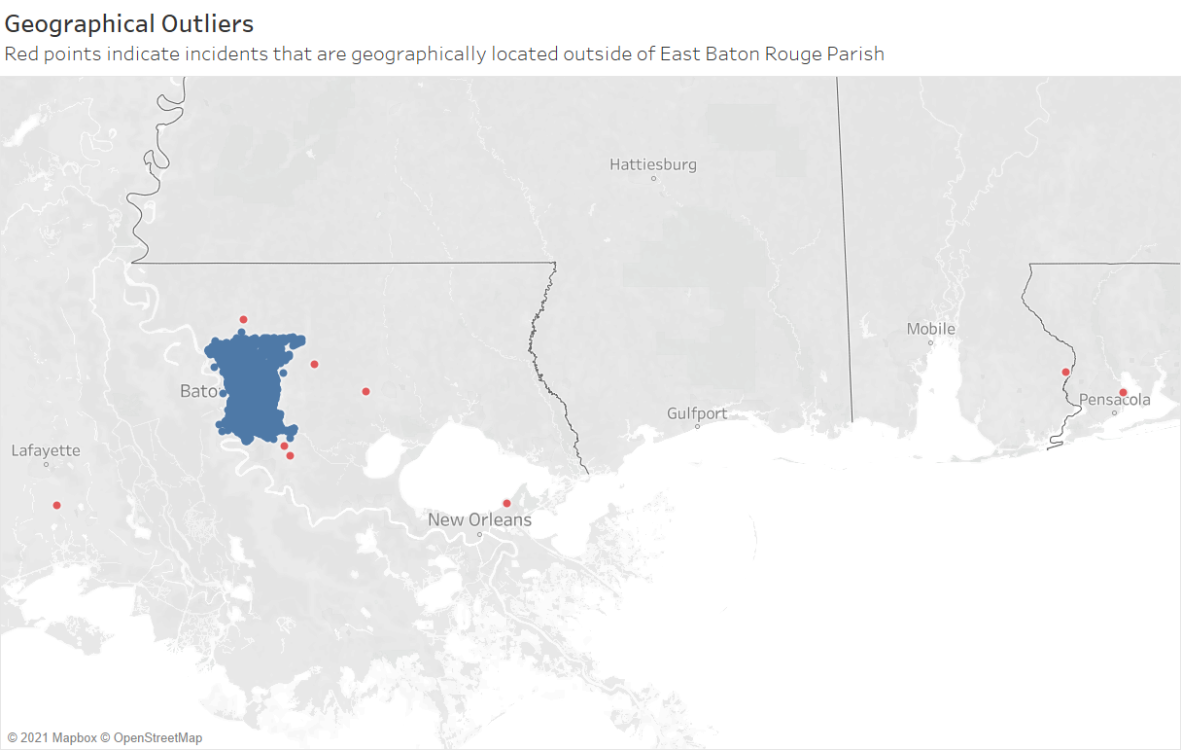
Notes:
First the entire dataset was plotted on a map and outliers were observed. The red dots indicated calls with geocoded areas outside of East Baton Rouge Parish. These could either be anomalies due to geocoding errors or isolated cases that required the officers to cross parish and state boundaries. Regardless, these incidents were removed to avoid skewing the analysis.

Slide 14
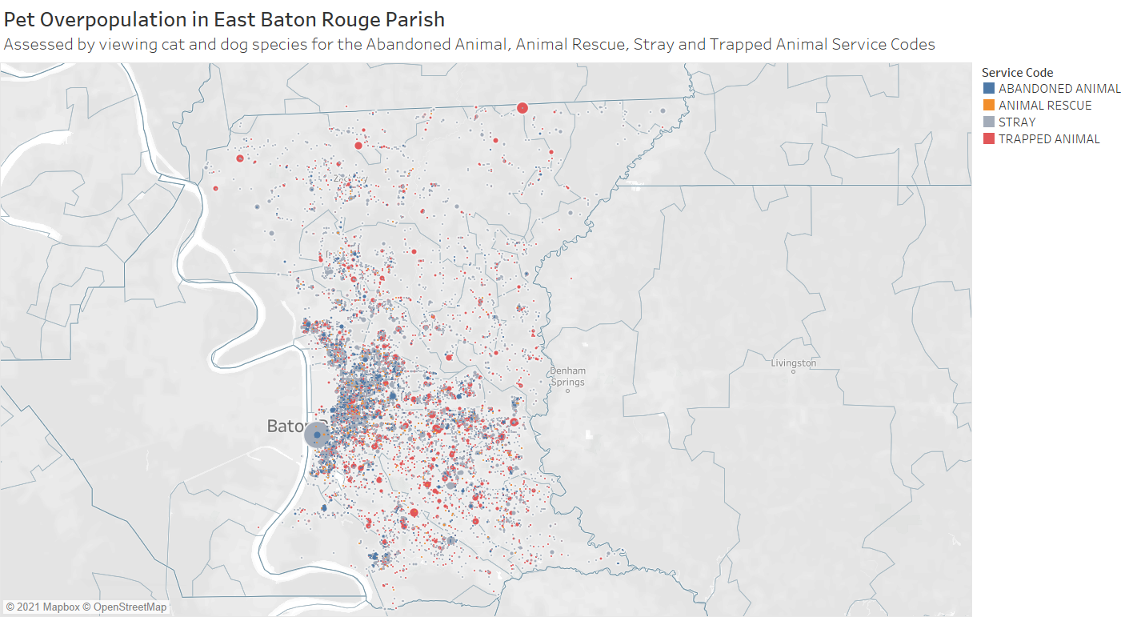
Notes:
The initial data point I wanted to observe to assess overpopulation was Age of the animal; however, the age value was 0 or missing in 99% of the incidents so it would not have been useful in the analysis. Instead, I chose to look at service codes that may likely to occur in areas where the majority of pets were not likely to be spayed or neutered. This map shows the Abandoned, Animal, Animal Rescue, Stray, and Trapped Animal service codes for cats and dogs. The largest grey dot representing strays is located just south of the industrial complex in Baton Rouge. This is a spot right along the river that contains plants, refineries and manufacturing facilities. The river is often a common dumping ground for unwanted animals. A large group of incidents involving trapped animals is in Zachary in northeast baton rouge. There seems to be other clusters for stray and trapped animals scattered throughout south baton rouge.

Slide 15
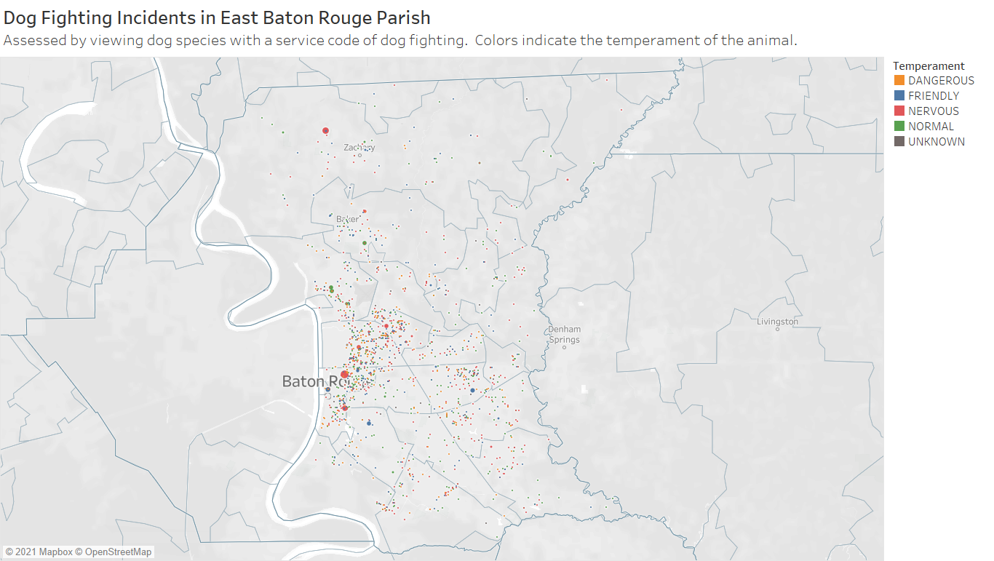
Notes:
To assess dog fighting in the area, I first looked at the incidents that were coded as dog fighting calls along with the temperament of the animals that were involved. Most dog fighting incidents seem to involve nervous dogs and some clusters can be observed again near the industrial complex and in Zachary.

Slide 16
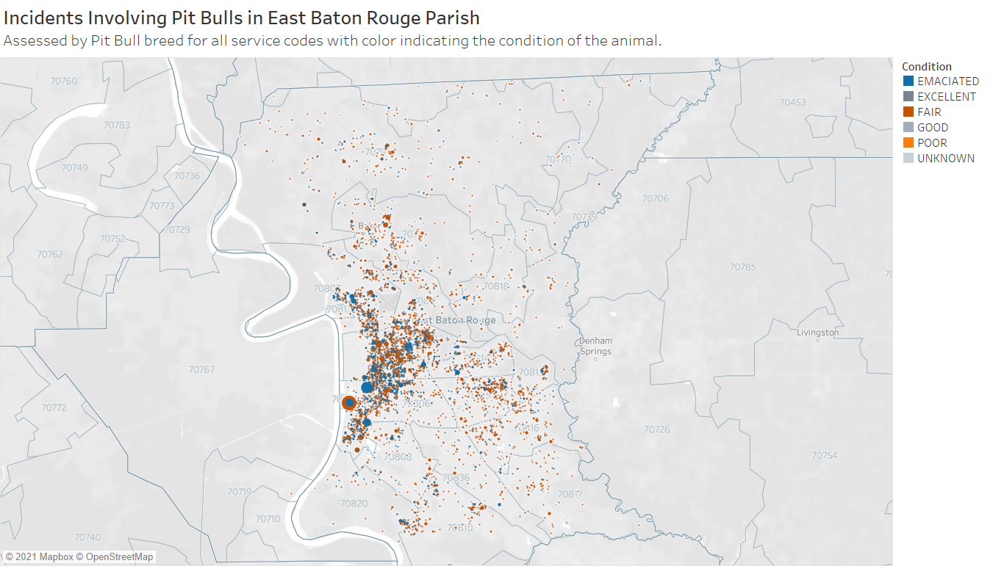
Notes:
Another approach to identifying areas that may contain unknown dog fighting rings is to look at pit bull incidents and the conditions in which the dogs were found. Unfortunately, the data was not specific as to whether the animals had wounds; however, the most relevant conditions would be fair, emaciated and poor. The emaciated clusters of incidents are located mostly in the city are of Baton Rouge. The largest concentration is again located south of the industrial complex.

Slide 17
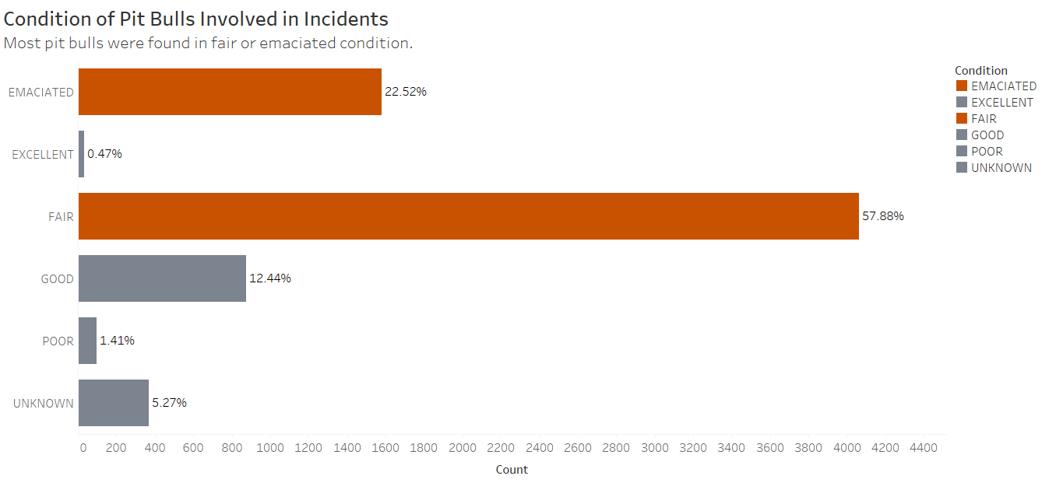
Notes:
I feel it is important to note that Pit Bulls picked up in incidents are most often in Fair condition at 57% followed by emaciated at 22%. Despite their likelihood of being in poor health and injured, 94% are transferred to the affiliated rescue for routing through the adoption process. More good news for pit bulls is that 70% have a friendly or normal temperament. Overall, dog fighting only represents .41% of all service codes reported during incidents in the time frame.

Slide 18
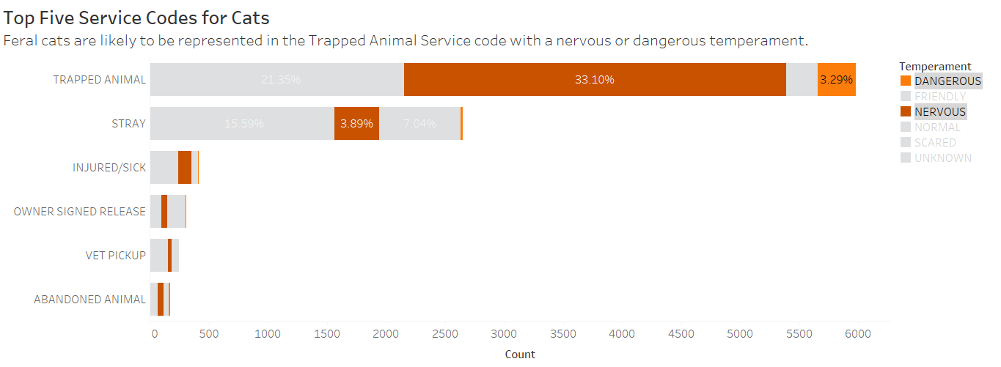
Notes:
Before assessing potential feral cat areas on the map, I reviewed the top service codes for cat incidents. The service code assigned to most of cat incidents is trapped animal at 58% followed by stray at 22%. Feral cats must be trapped because they will not tolerate human interaction. Looking closer at the trapped animals, 31% of them were labeled with a nervous temperament and 3% were labeled as dangerous. The top two service codes and temperaments highlighted in orange most likely identify feral cats.

Slide 19
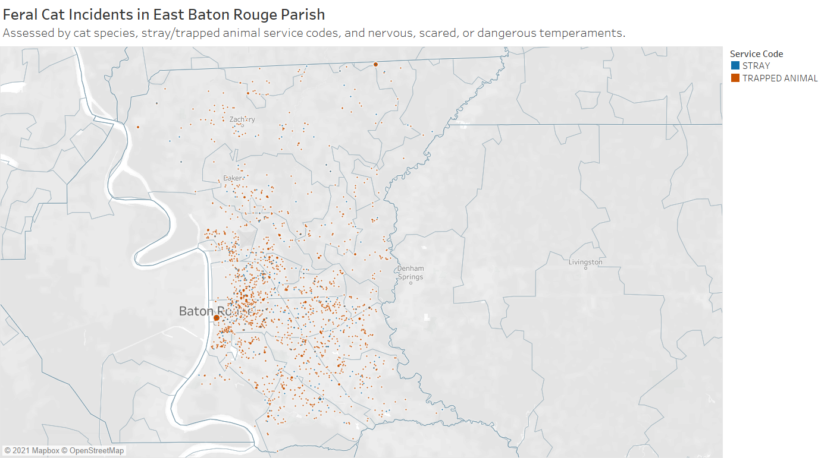
Notes:
To assess potential feral cat communities, incidents with the stray and trapped animal categories were plotted and filtered to only include cats that had nervous, scared or dangerous temperaments. Most of these incidents in the city of Baton Rouge, with a large number below the industrial complex and a small cluster in Zachary.

Slide 20

Condition
Class | Can be Predicted? | True Positive | False Positive
Emaciated |  | 80% | 38%
Poor |  | 72% | 50%
Fair |  | 70% | 45%
Good |  | 72% | 40%
Excellent |  | 70% | 10%
True Positive – The model correctly predicted the class.
False Positive – The model incorrectly predicted the class.
Most Important Predictors:
Call to Dispatch Time
Extra Large Size
Notes:
Animals in emaciated condition were predicted as emaciated 80% of the time; they were predicted as emaciated incorrectly 38% of the time.
Animals in poor condition were predicted as poor 72% of the time; they were predicted as poor incorrectly 50% of the time.
Animals in fair condition were predicted as fair 70% of the time; they were predicted as fair incorrectly 45% of the time.
Animals in good condition were predicted as good 72% of the time; they were predicted as fair incorrectly 40% of the time.
Animals in excellent condition were predicted as excellent 70% of the time; they were predicted as excellent incorrectly10% of the time. Originally, the excellent condition received a score of true positive predictions at 84%; however the animals predicted as excellent but ere not was 70%. This is too high of a false positive rate to be wrong in the event that the staff is inexperienced or unprepared to handle the situation. A more acceptable cut off would be at 75% of excellent animals predicted correctly with a 10% of animals who were predicted in excellent condition being wrong.
The most important variables in predicting the condition were the call to dispatch time and the extra large sized animals.

Slide 21

Temperament
Class | Can be Predicted? | True Positive | False Positive
Dangerous |  | 80% | 32%
Scared |  | 49% | 50%
Nervous |  | 80% | 38%
Normal |  | 70% | 20%
Friendly |  | 86% | 20%
True Positive – The model correctly predicted the class.
False Positive – The model incorrectly predicted the class.
Most Important Predictors:
Call to Dispatch Time
Other Species
Notes:
Dangerous animals were predicted as such 80% of the time; they were predicted as dangerous incorrectly 32% of the time.
Scared animals were predicted as such 49% of the time; this means the model is an ineffective predictor of scared animals as it does not improve the true positive prediction rate over 50%.
Nervous animals were predicted accurately 80% of the time; they were predicted as nervous incorrectly 38% of the time.
Originally, the normal condition received a score of true positive predictions at 81%; however, the animals predicted as normal but were not was 50%. This is too high of a false positive rate to be wrong in the event that the staff is inexperienced or unprepared to handle the situation. A more acceptable cut off would be at 70% of normal animals predicted correctly with a 20% of animals who were predicted as normal being wrong.
Friendly animals were predicted as friendly 86% of the time; they were predicted as excellent incorrectly 10% of the time.
The most important predictors of the temperament was the call to dispatch time and the other species group. Other species are wildlife or live stock and will most likely be dangerous, nervous or scared.

Slide 22
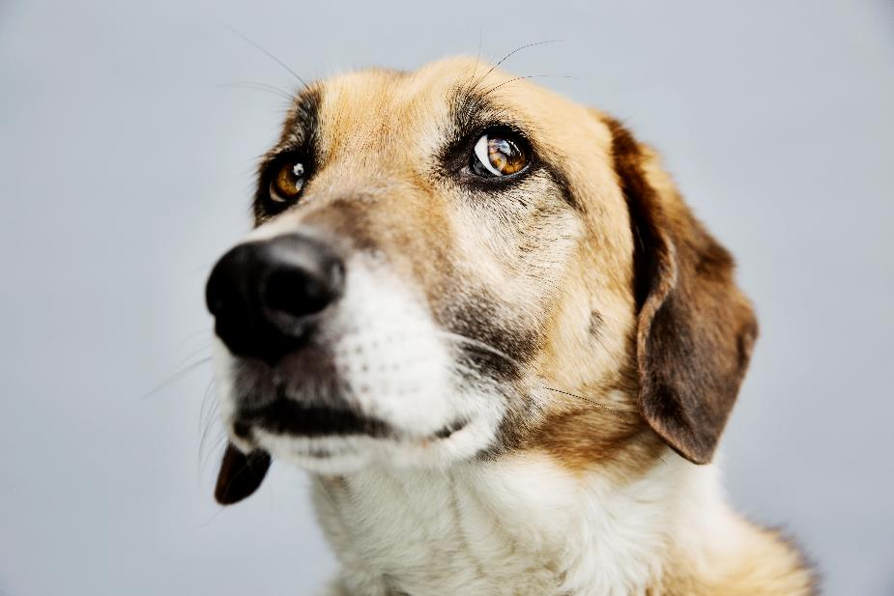
What does it all mean?
Notes:
The objective of this project was to analyze animal control incident data to determine if it can provide vital information that could improve the welfare of animals in each community. Overall, we can say that yes, this data can be helpful in directing locations for additional animal welfare support programs. In each of the problems we assessed, pet overpopulation, dog fighting, and feral cat control, most incidents were centered around the city of Baton Rouge with a large number just south of the Industrial Complex. Additional patrols can be set up in this area to determine why these problems are so prevalent there. Before introducing new programs into the area, further analysis should be completed on the specific neighborhoods within the city of Baton Rouge to isolate any clusters. The predictive models were effective at predicting conditions and temperaments that would be most beneficial to know before an animal control officer arrives on the scene. This model could be used as part of an alert system within the animal control dispatch software to notify them that initial support is needed. The model should be tested further on unseen data to further evaluate its effectiveness.

Slide 23
References
[1] (2012-2019) Baton Rouge, LA Animal Control Calls. (n.d.). Retrieved March 20, 2021, from https://kaggle.com/dustinec/2019-baton-rouge-la-animal-control-calls
[2] Animal Control & Rescue Center | Baton Rouge, LA. (n.d.). Retrieved March 20, 2021, from https://www.brla.gov/148/
[3] Animal-Control-Rescue-CenterAnimal Control Incidents | Open Data BR. (n.d.). Retrieved March 20, 2021, from https://data.brla.gov/Public-Safety/Animal-Control-Incidents/qmns-hw3s
[4] Pet Statistics | Shelter Intake and Surrender | ASPCA. (n.d.). Retrieved March 20, 2021, from https://www.aspca.org/animal-homelessness/shelter-intake-and-surrender/pet-statisticsRuhrfisch, U. C. (2007).
[5] Map of East_Baton_Rouge Parish, Louisiana, United States with municipal boundaries. taken from US Census website [1] and modified by User:Ruhrfisch. https://commons.wikimedia.org/wiki/File:Map_of_East_Baton_Rouge_Parish_Louisiana_With_Municipal_Labels.PNG

Slide 24
Contact me
Rebecca V. Lewis
Email: revlewis79@gmail.com
Portfolio: RebeccaLewis-DS.github.io
LinkedIn: https://www.linkedin.com/in/rebeccavlewis/

